Slide 1




HTTP Basics
HTTP Request & HTTP Response
Software
Technologies
SoftUni Team
Technical Trainers
Software University
http://softuni.bg

Slide 2



Table of Contents
HTTP Basics
HTTP Request
HTTP Response
URL

Slide 3
Have a Question?
sli.do #tech-softuni

Slide 4

HTTP Basics
Request and Responses

Slide 5



HTTP Basics
HTTP (Hyper Text Transfer Protocol)
Text-based client-server protocol for the Internet
For transferring Web resources (HTML files, images, styles, etc.)
Request-response based
HTTP request
HTTP response
Web Client
Web Server

Slide 6



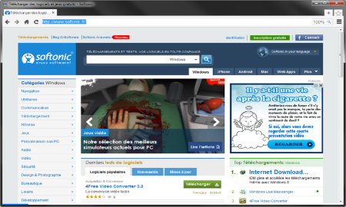





Web Server Work Model
Web Client
Web Server
Technology
Request
Response
Web Resources
Database
HTML, PDF, JPG…

Slide 7

Dev Tools
Tools for Developers

Slide 8
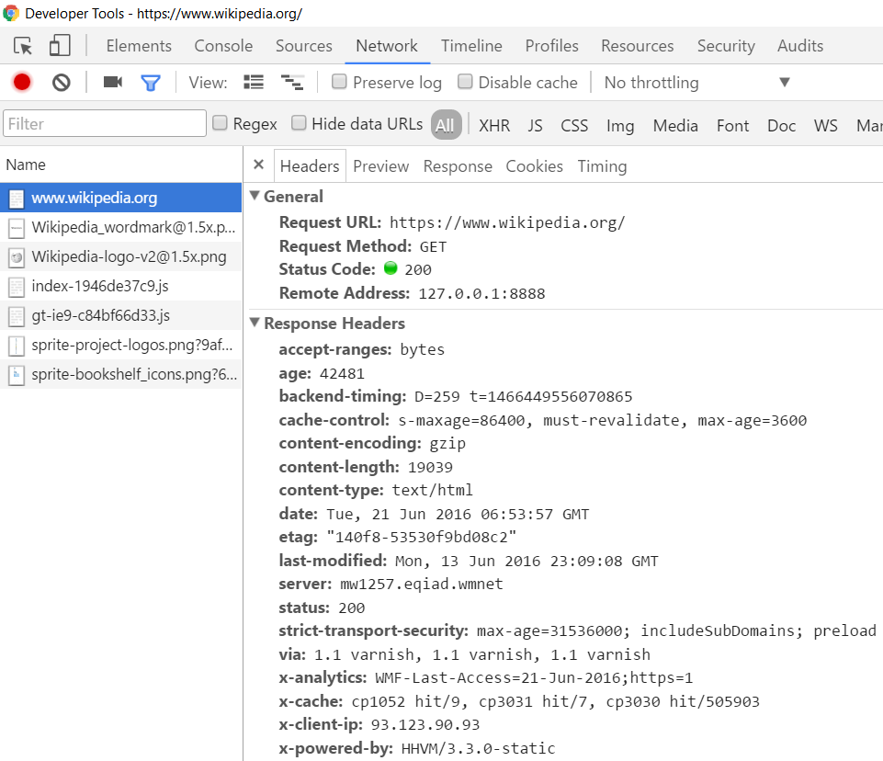

HTTP Developer Tools
Chrome Developer Tools
Postman

Slide 9

HTTP Request
What is a HTTP Request?

Slide 10






HTTP Request Methods
HTTP defines methods to indicate the desired action to be performed on the identified resource
Method | Description
GET | Retrieve / load a resource
POST | Create / store a resource
PUT | Update a resource
DELETE | Delete (remove) a resource
PATCH | Update resource partially
HEAD | Retrieve the resource's headers

Slide 11
HTTP GET Request – Example
GET /users/Tech-Module-Jan-2018/repos HTTP/1.1
Host: api.github.com
Accept: */*
Accept-Language: en
Accept-Encoding: gzip, deflate
User-Agent: Mozilla/5.0 (Windows NT 10.0; WOW64) AppleWebKit/537.36 (KHTML, like Gecko) Chrome/54.0.2840.71 Safari/537.36
Connection: Keep-Alive
Cache-Control: no-cache
<CRLF>
HTTP request line
HTTP headers
The request body is empty

Slide 12
HTTP POST Request – Example
POST /repos/Tech-Module-Jan-2018/test-repo/issues HTTP/1.1
Host: api.github.com
Accept: */*
Accept-Language: en
Accept-Encoding: gzip, deflate
User-Agent: Mozilla/4.0 (compatible;MSIE 6.0; Windows NT 5.0)
Connection: Keep-Alive
Cache-Control: no-cache
<CRLF>
{"title":"Found a bug",
"body":"I'm having a problem with this.",
"labels":["bug","minor"]}
<CRLF>
HTTP request line
HTTP headers
The request body holds the submitted data

Slide 13

HTTP Response
What is a HTTP Response?

Slide 14
HTTP Response – Example
HTTP response status line
HTTP/1.1 200 OK
Date: Fri, 11 Nov 2016 16:09:18 GMT+2
Server: Apache/2.2.14 (Linux)
Accept-Ranges: bytes
Content-Length: 84
Content-Type: text/html
<CRLF>
<html>
<head><title>Test</title></head>
<body>Test HTML page.</body>
</html>
HTTP response headers
HTTP response body

Slide 15
HTTP Response Status Codes
Status Code | Action | Description
200 | OK | Successfully retrieved resource
201 | Created | A new resource was created
204 | No Content | Request has nothing to return
301 / 302 | Moved | Moved to another location (redirect)
400 | Bad Request | Invalid request / syntax error
401 / 403 | Unauthorized | Authentication failed / Access denied
404 | Not Found | Invalid resource
409 | Conflict | Conflict was detected, e.g. duplicated email
500 / 503 | Server Error | Internal server error / Service unavailable

Slide 16
Content-Type and Disposition
The Content-Type / Content-Disposition headers specify how the HTTP request / response body should be processed
Examples:
JSON-encoded data
UTF-8 encoded HTML page. Will be shown in the browser
Content-Type: application/json
Content-Type: text/html; charset=utf-8
Content-Type: application/pdf
Content-Disposition: attachment; filename="Financial-Report-April-2016.pdf"
This will download a PDF file named Financial-Report-April-2016.pdf

Slide 17
HTTP Conversation: Example
GET /trainings/courses HTTP/1.1
Host: www.softuni.bg
User-Agent: Mozilla/5.0
<CRLF>
HTTP request:
HTTP response:
The empty line denotes the end of the request header
HTTP/1.1 200 OK
Date: Tue, 16 Jan 2018 15:13:41 GMT
Server: Microsoft-HTTPAPI/2.0
Last-Modified: Tue, 16 Jan 2018 15:13:42 GMT
Content-Length: 18586
<CRLF>
<html><title>Курсовете от…
</title>
The empty line denotes the end of the response header

Slide 18

URL
Uniform Resource Locator

Slide 19
Uniform Resource Locator (URL)
http://mysite.com:8080/demo/index.php?id=27&lang=en#lectures
Protocol
Host
Port
Path
Query String
Fragment
Protocol for communicating (http, ftp, https...) – HTTP in most cases
Host or IP address (www.softuni.bg, gmail.com, 127.0.0.1, web)
Port (the default port is 80) – a number in range [0…65535]
Path (/forum, /path/index.php)
Query string (?id=27&lang=en)
Fragment (#lectures) – used on the client to navigate to some section

Slide 20
Summary
HTTP works with message pairs called HTTP request and HTTP response
The URL parts define:
protocol, host, port, path, query string, and fragment
GET /trainings/courses HTTP/1.1
Host: www.softuni.bg
User-Agent: Mozilla/5.0
<CRLF>
HTTP/1.1 200 OK
…
<CRLF>
<html><title>…

Slide 21










HTTP Basics
https://softuni.bg/courses/software-technologies

Slide 22





Trainings @ Software University (SoftUni)
Software University – High-Quality Education, Profession and Job for Software Developers
softuni.bg
Software University Foundation
http://softuni.foundation/
Software University @ Facebook
facebook.com/SoftwareUniversity
Software University Forums
forum.softuni.bg

